Slide 1
Just a quick, useless recap
What happened last semester!

Slide 2





The Curse of Hamilton’s Chairs
Ahmed Shalaby
2nd year PhD
Supervisor: Damien Woods

Slide 3
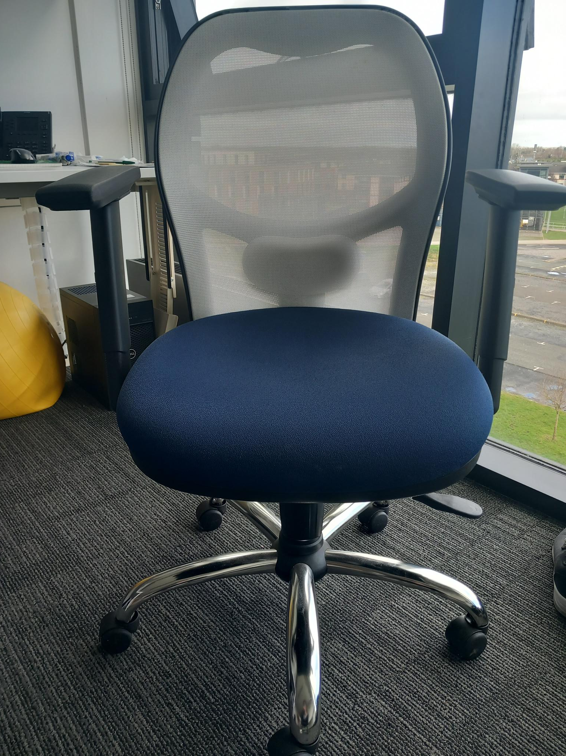
Let’s discover the rules of the game

Slide 4




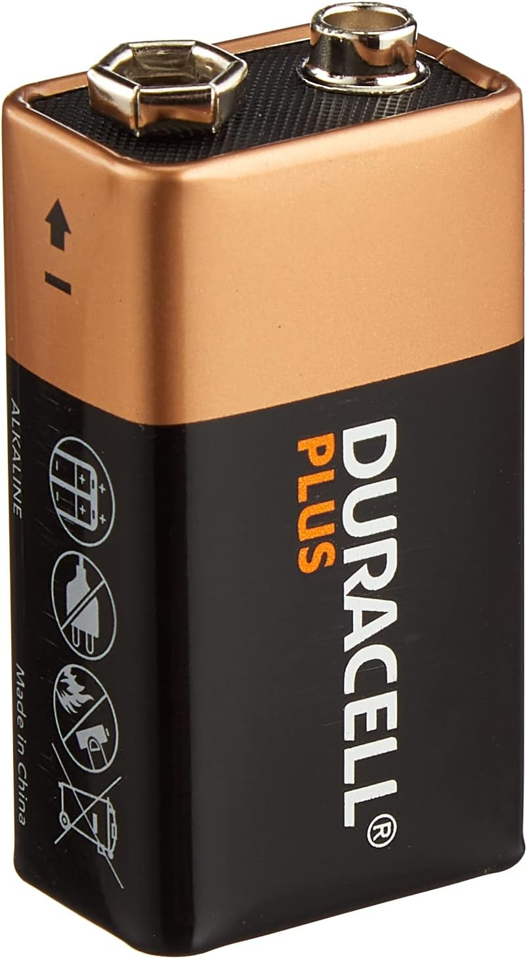







1
1
1
1
2
2
2
2
...
...
...
PhD students
With colored clothes and gloves
...
$$k_{1}$$
$$k_{2}$$
$$k_{3}$$
$$k_{N}$$
Damien
. . .
Hamilton
1
2
3
N
How many different configurations we will have ?
$${(K+1)}^{N}$$
(Exponential in the # of chairs)

Slide 5


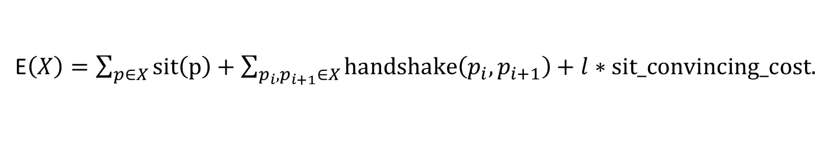



Emma
Yc
Akash
$$X$$
Damien
1
2
3
4
5
Hamilton
$$E\left(X\right)=sit\left(Emma\right)+sit\left(Yc\right)+sit\left(Akash\right)+handshake\left(Emma,Yc\right)$$
$+ 3∗sit_convincing_cost$.
+
+
+
+
-
E$\left(X\right)=\sum_{p∈X}{sit\left(p\right)+\sum_{p_{i},p_{i+1}∈X}{handshake\left(p_{i},p_{i+1}\right)+l∗sit_convincing_cost.}}$
configuration $X^{ }$ of size $l$PhD students
We further assume the following:
$|sit(p)|>|sit_convincing_cost|$. (Damien always gains by convincing a PhD student to sit)

Slide 6

Built–in self improvement mechanism
PhD students' displacement system
Hola!
Akash
Paddy
Paddy
Yc
Akash
Blake
Damien
1
2
3
4
Hamilton

Slide 7
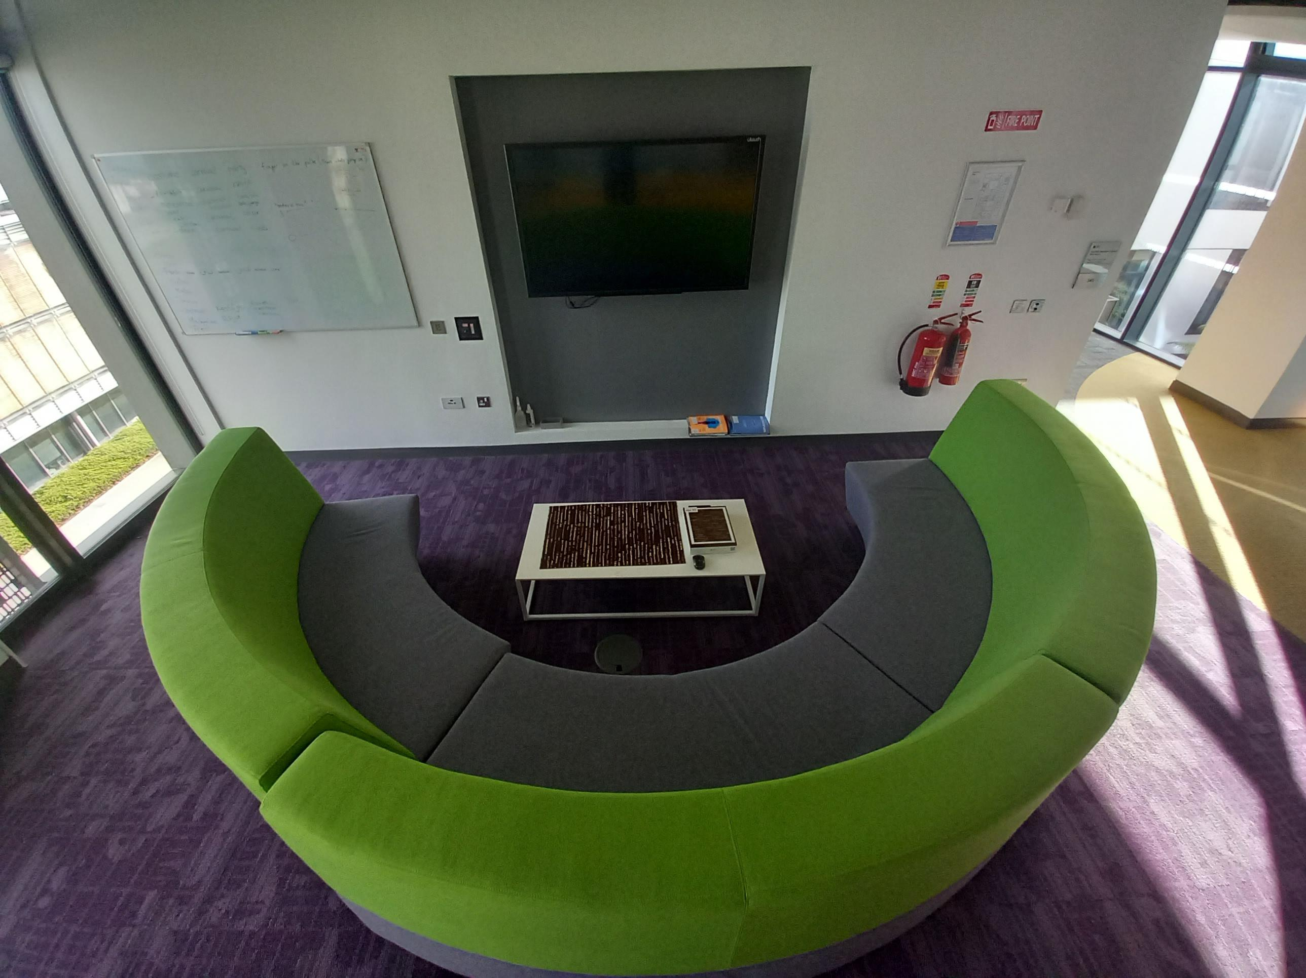
When you don’t set your boundaries

Slide 8




An efficient minimum free energy algorithm for interacting nucleic acid strands
The Curse of Hamilton’s Sofa
How I discovered that my supervisor is actually a
VAMPIRE
Ahmed Shalaby
2nd year PhD
Supervisor: Damien Woods

Slide 9
Let’s discover the rules of the game

Slide 10








In a perfect world
Abstract Algebra
Graph theory
Algorithm analysis
Number theory

Slide 11
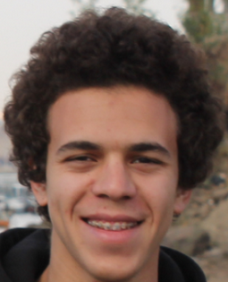


Ahmed’s goal
Modelling
What is his mindset?
What he prefers?
Computation
PI
?
?
?

Slide 12

Once Upon a Time in Hamilton
Email
From
Rosemary
Kate

Slide 13


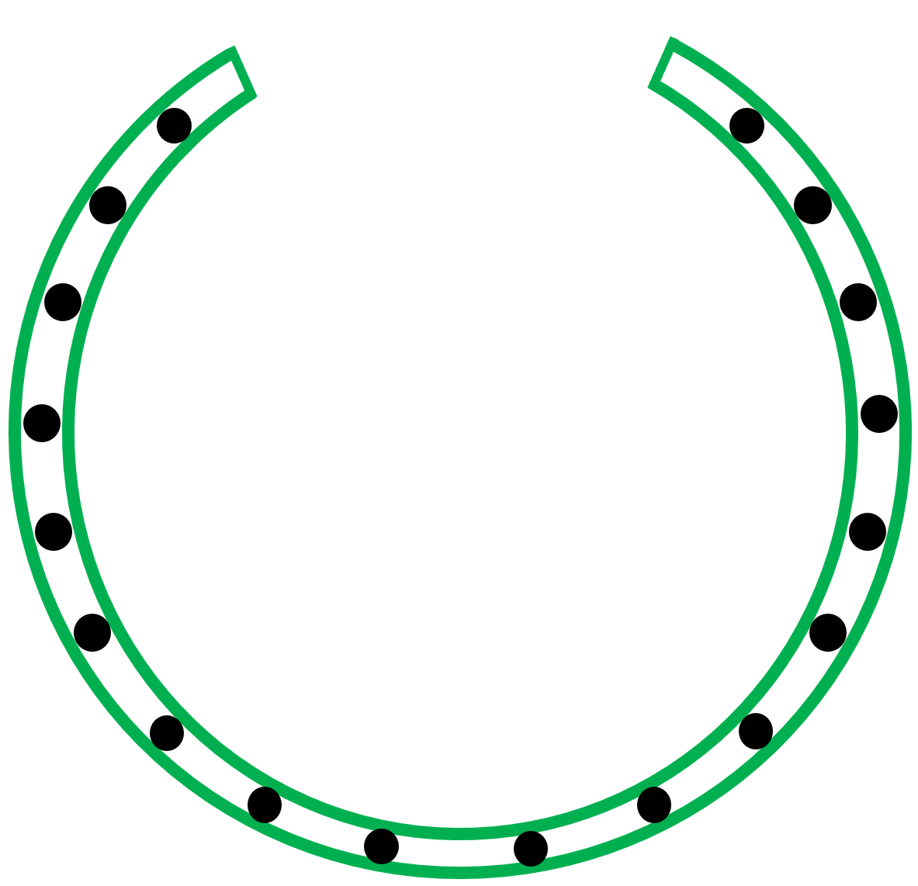
Hamilton game

Slide 14
Level 1

Slide 15
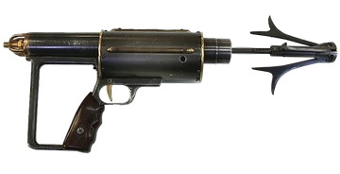
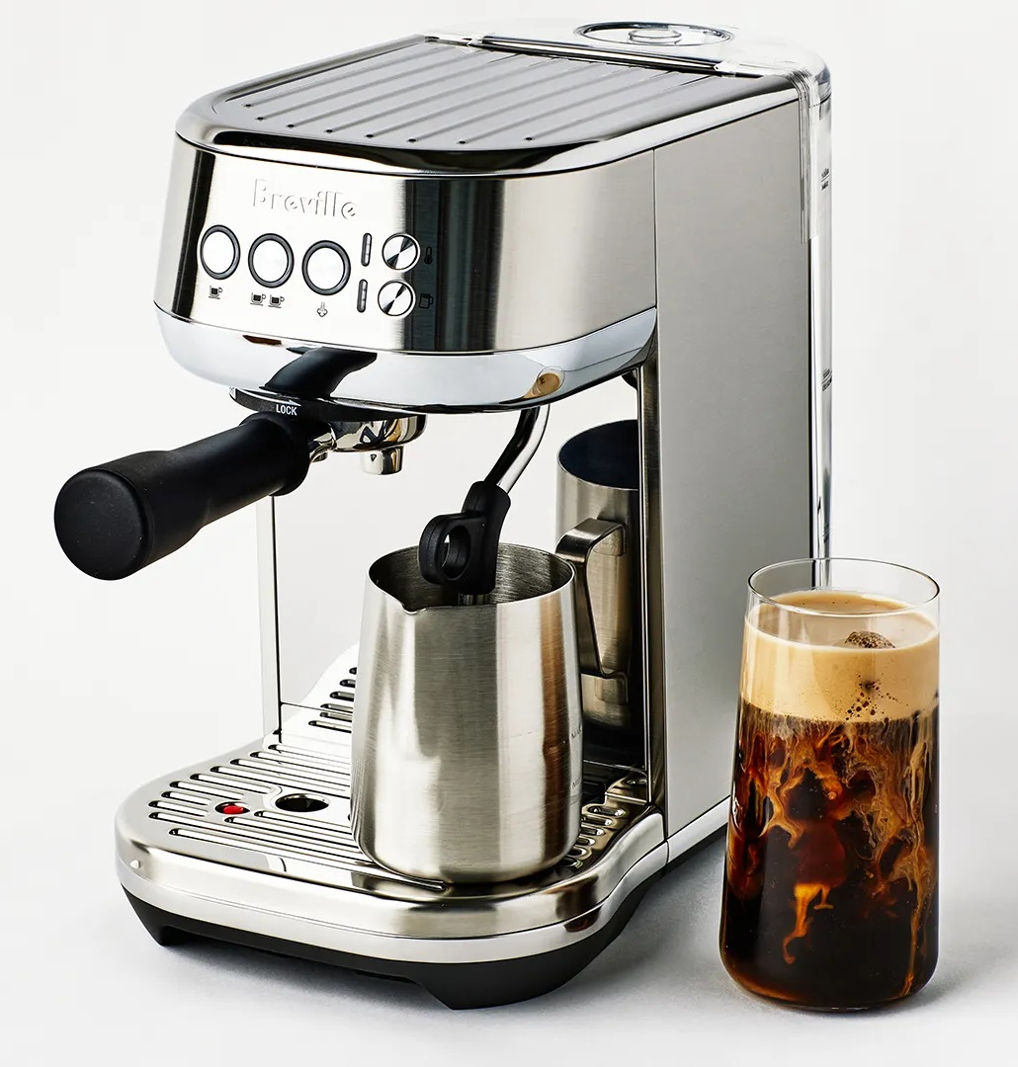
Hamilton game
First year
Second year
Third year
fourth year
Daniel
Augustina
.
.
.
Ahmed
Andre
Paddy
Cormac
.
.
Dara
Solmaz
Oluwayomi
.
.
.
Akash
Yc
Emma
Darshana
.
.
Don’t trust our new lab
Akash
Akash
Akash
Akash
.
Dara
Dara
Dara
Dara
.
Darshana
Darshana
Darshana
Darshana
.
Fergal
Fergal
Fergal
Fergal
.
. . .
Ahmed

Slide 16
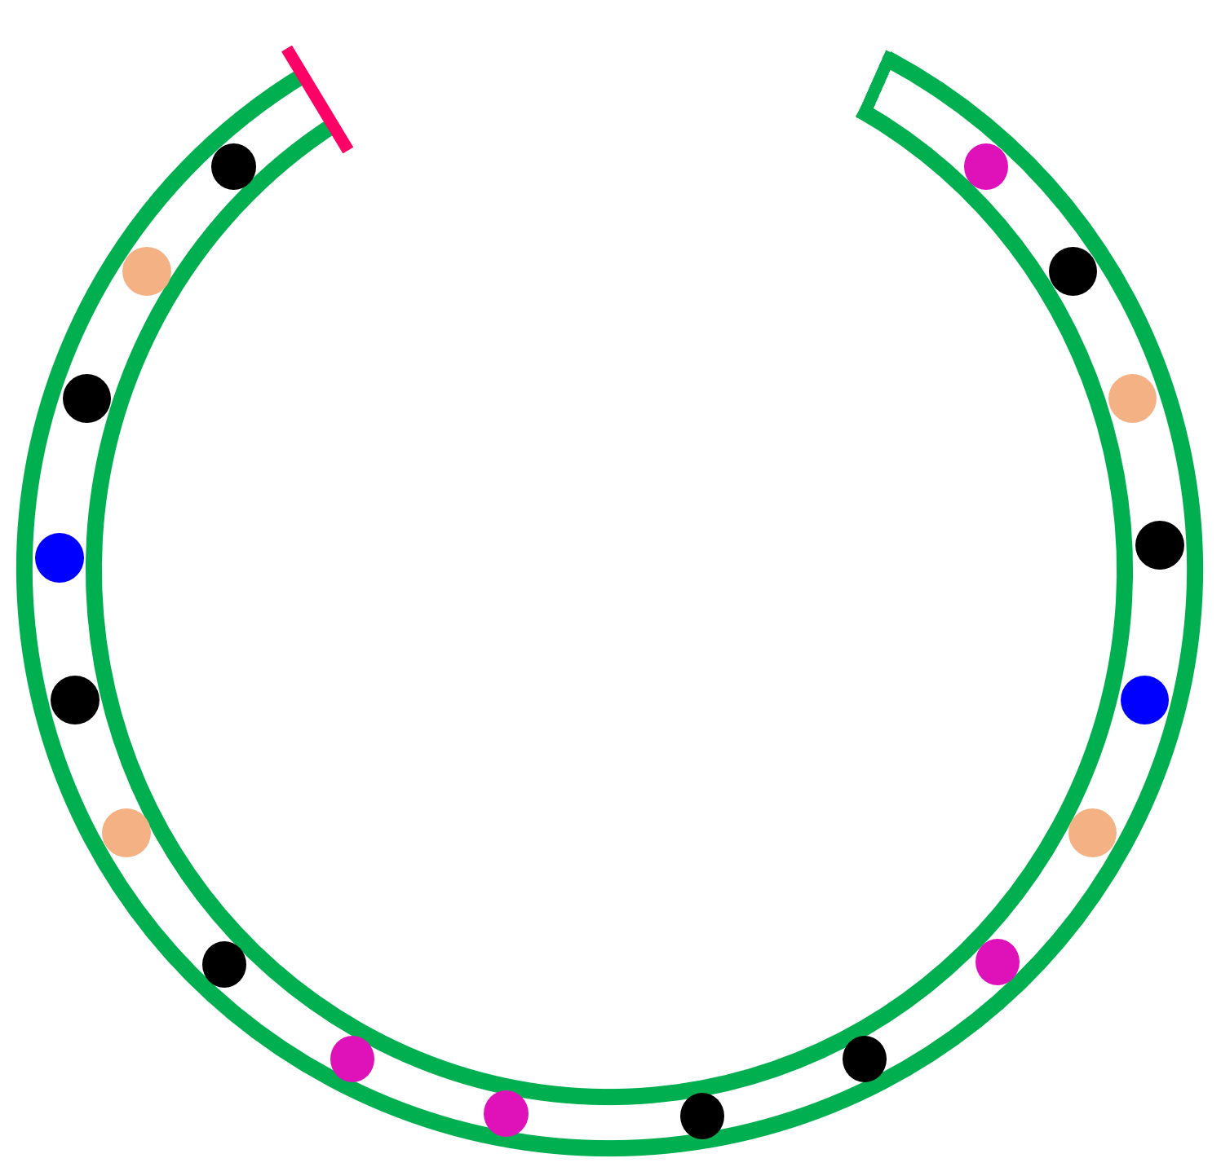
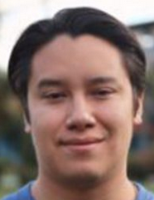

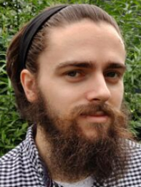
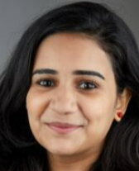
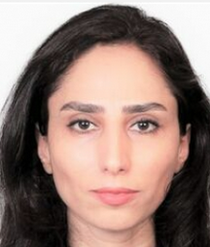
Rules of Hamilton game

Slide 17
Rules of Hamilton game
If you kill, you are safe

Slide 18
Rules of Hamilton game
If you kill, you are safe
You can only kill one student, you have only one bullet

Slide 19
Rules of Hamilton game
If you kill, you are safe
You can only kill one student, you have only one bullet
You can be killed once

Slide 20
Rules of Hamilton game
If you kill, you are safe
You can only kill one student, you have only one bullet
You can be killed once
You must respect other killers, you can’t cross their killing lines

Slide 21
Rules of Hamilton game
If you kill, you are safe
You can only kill one student, you have only one bullet
You can be killed once
You must respect other killers, you can cross their killing line
Ahmed can only kill, he’s an immortal man

Slide 22
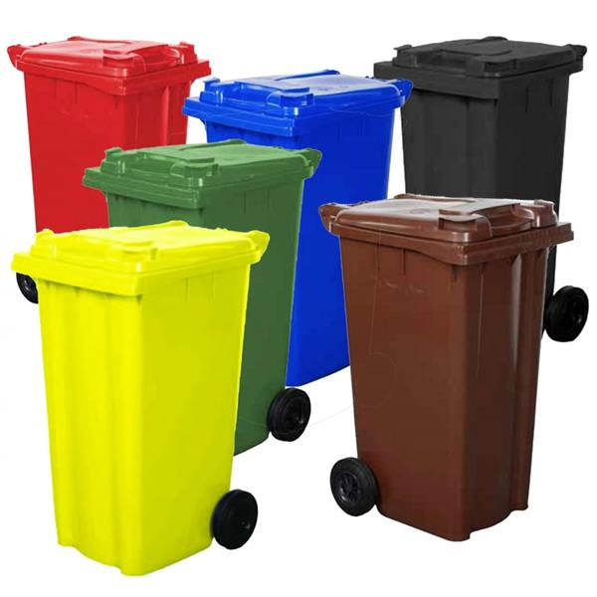
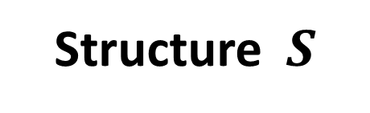
Structure $S$

Slide 23
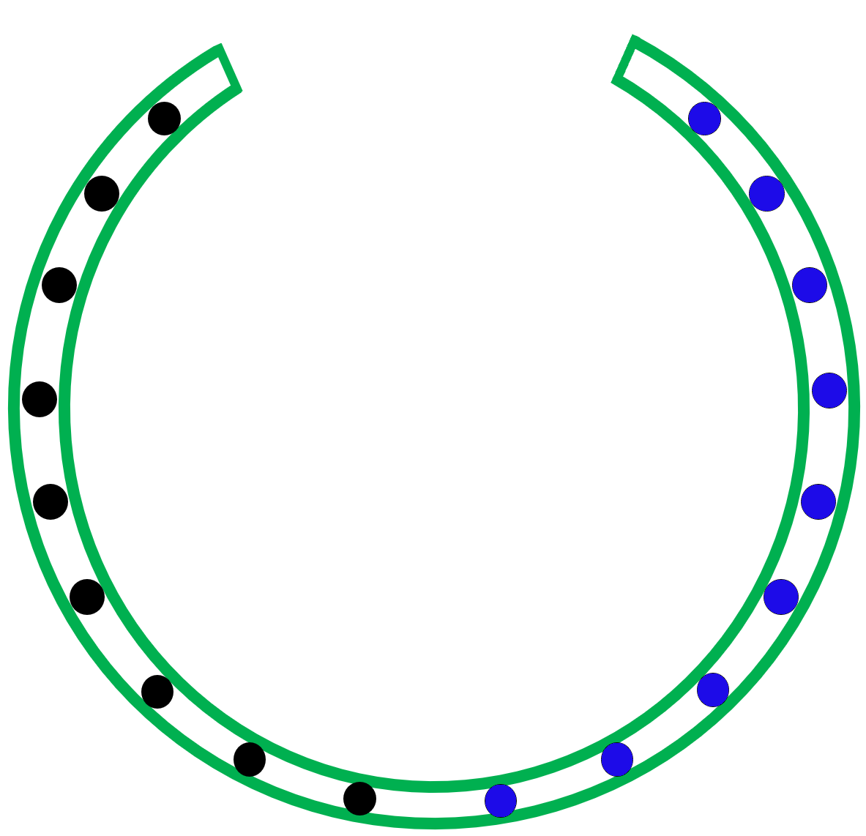
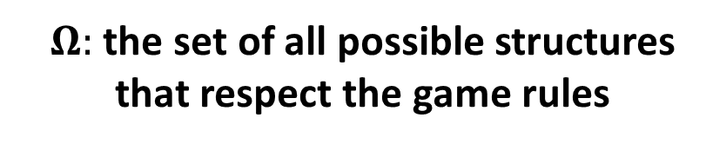
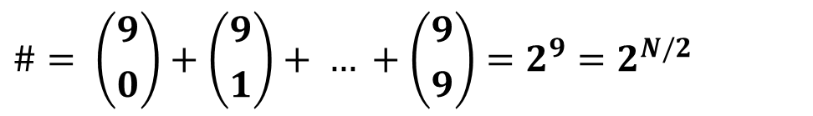
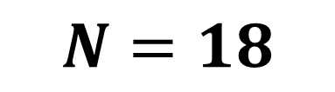
$$N=18$$
$$\#= \left({9 \atop 0}\right)+\left({9 \atop 1}\right)+ … +\left({9 \atop 9}\right)=2^{9}=2^{N/2}$$
$Ω:$ the set of all possible structures that respect the game rules
Huge
4th
2nd

Slide 24



Possible scenarios
$$S_{1}$$
$$S_{2}$$
$$S_{3}$$
Not cool
Getting better
Much better

Slide 25
Ahmed’s goal
PI
Loves more blood
?
?
?

Slide 26
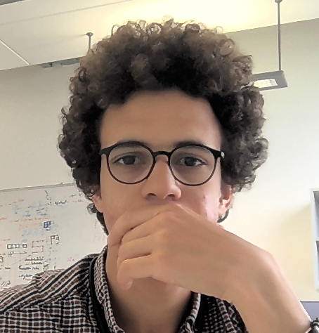
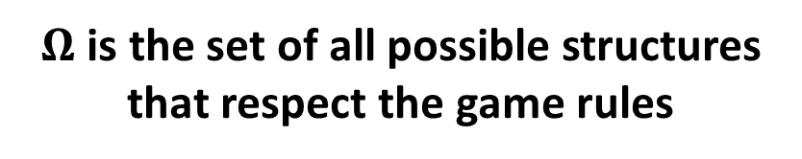

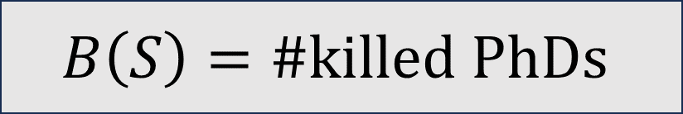
S
?
?
Some Criteria/Model
$$B\left(S\right)=\#killed PhDs$$
$$\max_{S∈Ω}{B(S)}$$
$Ω$ is the set of all possible structures that respect the game rules
How to compute this fast?
That is so cool!

Slide 27
Level 2

Slide 28
After playing that game over and over
Blood freshness
1st
2nd
3rd
4th

Slide 29
Ahmed’s goal
PI
Loves high quality blood
?
?
?

Slide 30

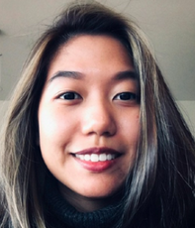

mixed blood

Slide 31
Ahmed’s goal
PI
Loves high quality blood
Loves mixed blood
?
?

Slide 32
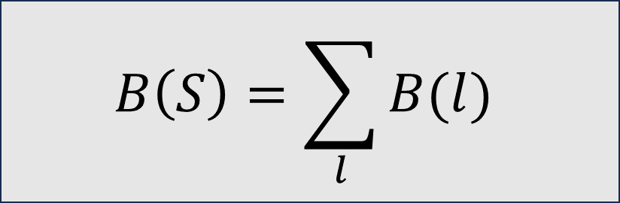







$$S$$
$$l_{5}$$
?
Some Criteria/Model
$$l_{4}$$
$$B\left(S\right)=\sum_{l}{B(l)}$$
$$l_{3}$$
$$l_{2}$$
$$l_{1}$$
$$\max_{S∈Ω}{B(S)}$$
How to compute this fast?

Slide 33
Level 3

Slide 35

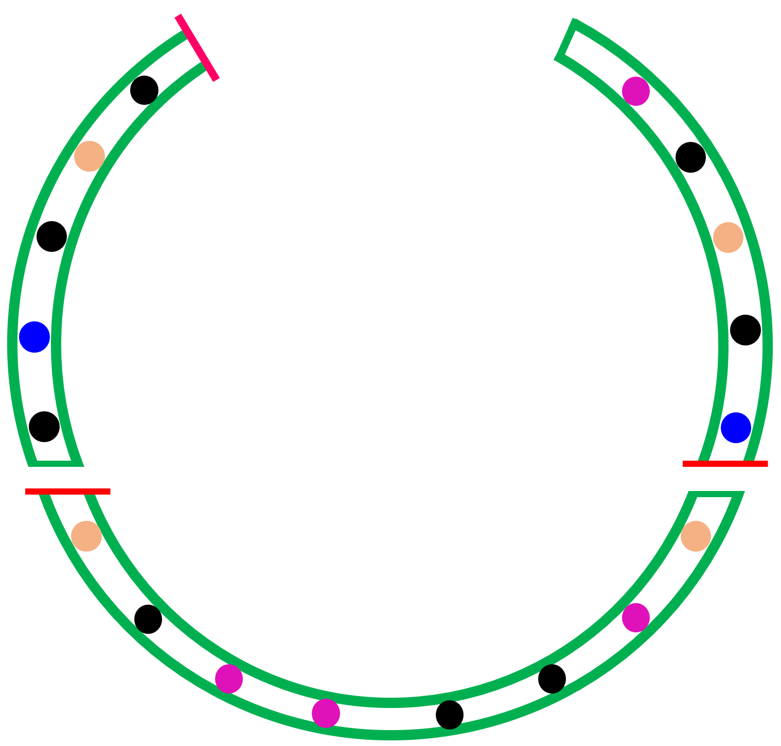


c = 3 sofas
C
A
B
That is so bad!

Slide 36
Ahmed’s goal
PI
Loves high quality blood
Loves mixed blood
Hates disconnectedness
?

Slide 37





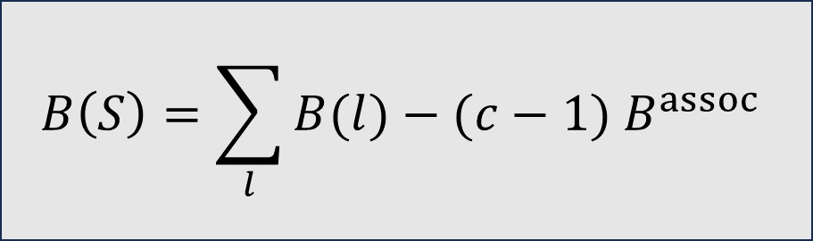
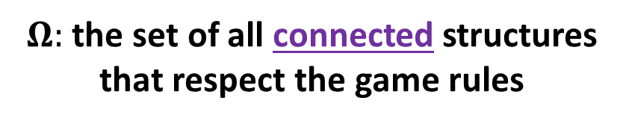


$$S$$
c = 3 sofas
$$l_{5}$$
?
$$l_{4}$$
Some Criteria/Model
$$B\left(S\right)=\sum_{l}{B(l)}−(c−1) B^{assoc}$$
$$l_{3}$$
$$l_{2}$$
$$\max_{S∈Ω}{B(S)}$$
$$l_{1}$$
$Ω:$ the set of all connected structures that respect the game rules
How to compute this fast?

Slide 38
Level 4

Slide 40
c = 4 sofas
A
A
A
A
That is ok!

Slide 41
c = 4 sofas
A
A
A
A
That is ugh!

Slide 42
c = 4 sofas
A
A
A
A
That is ugh ugh!

Slide 43
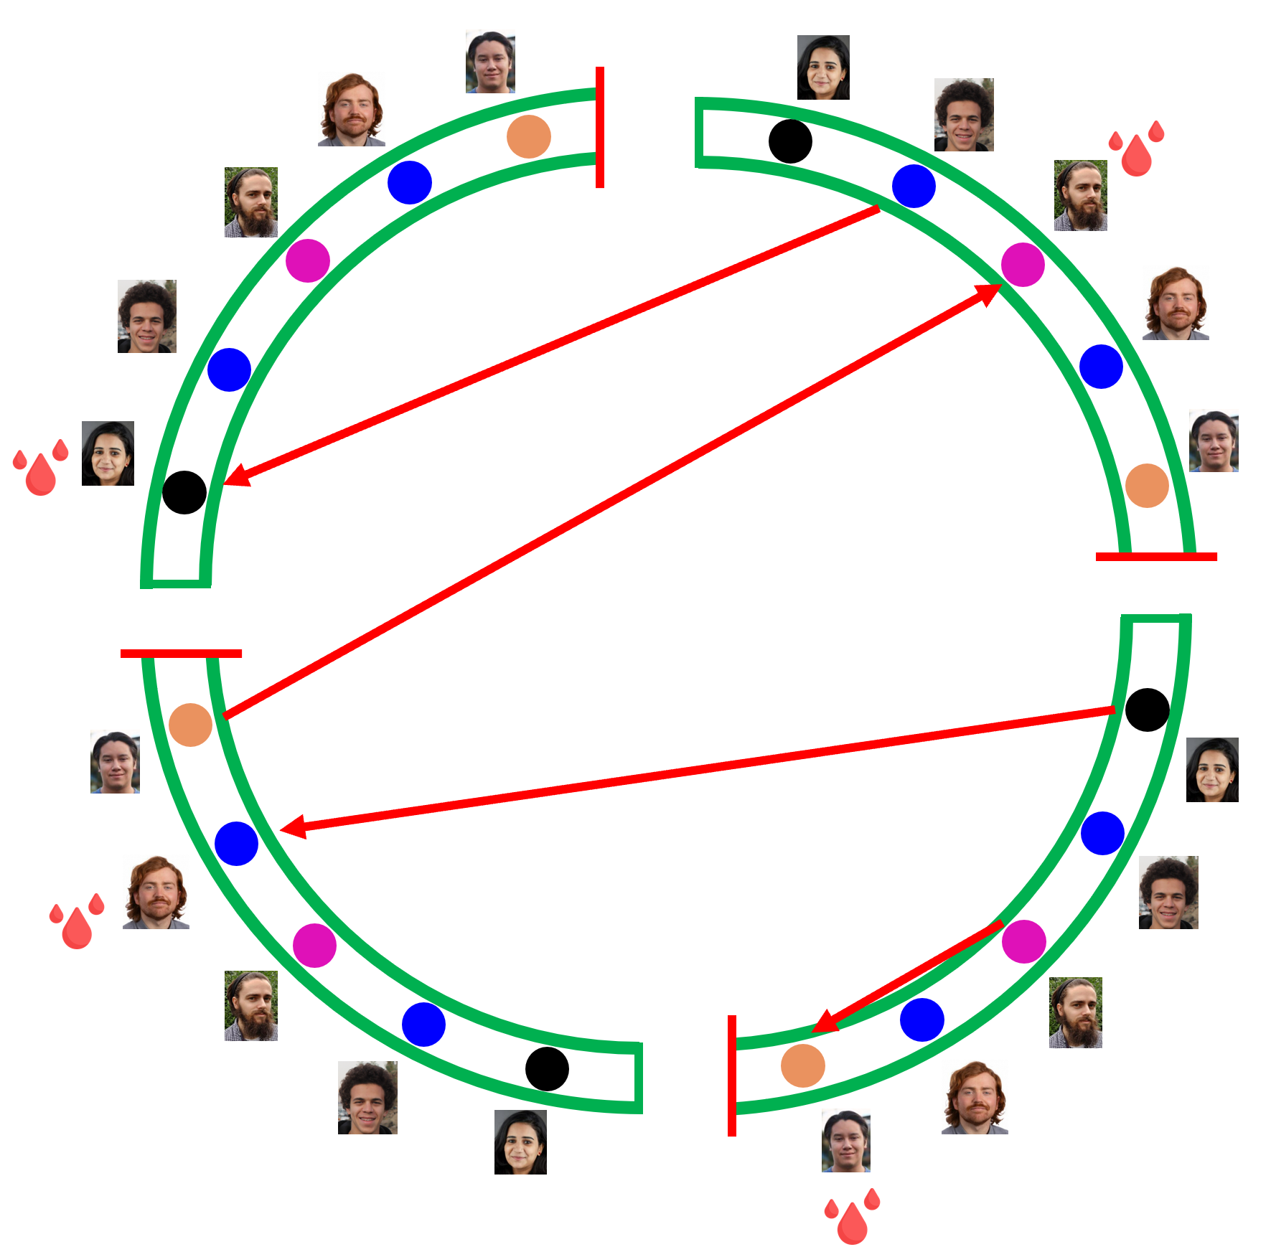
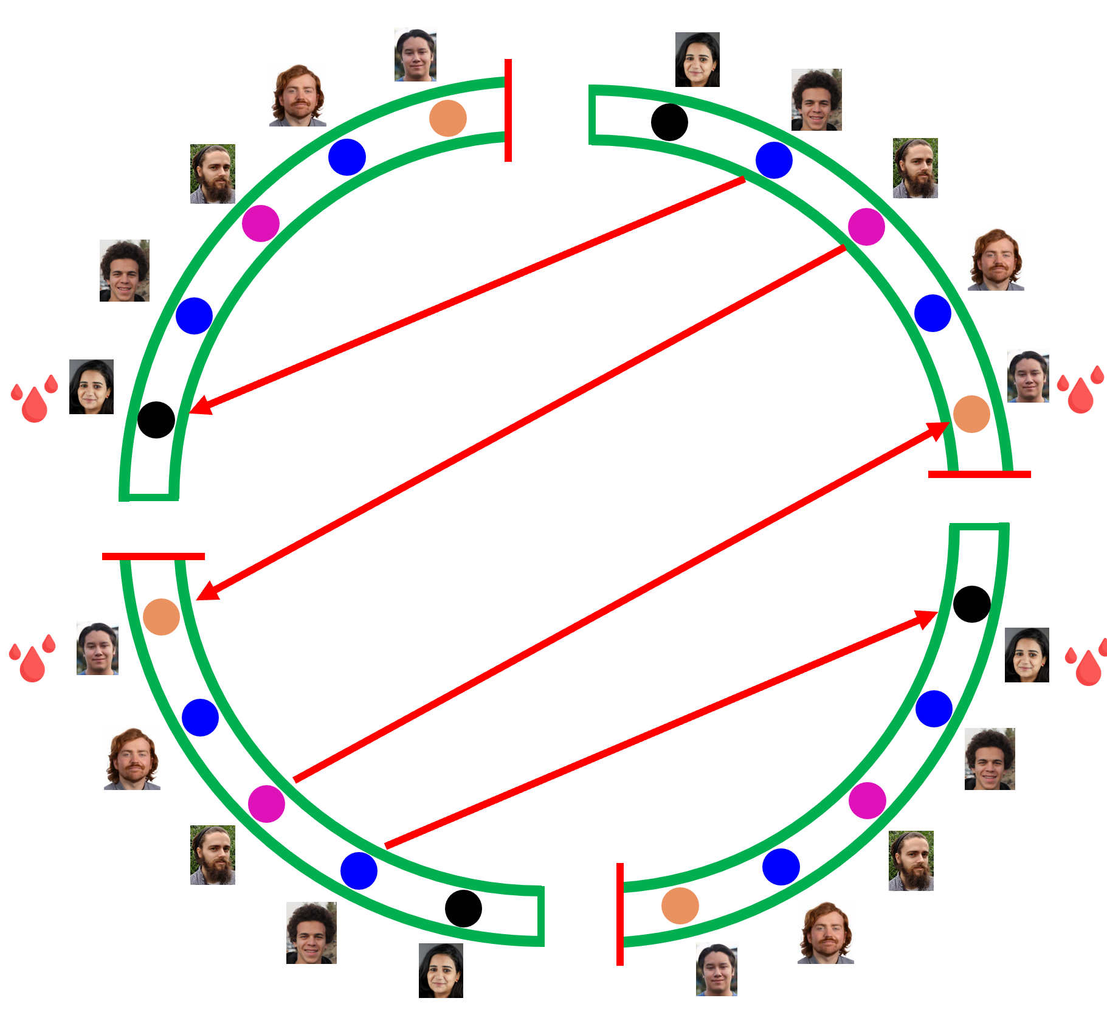
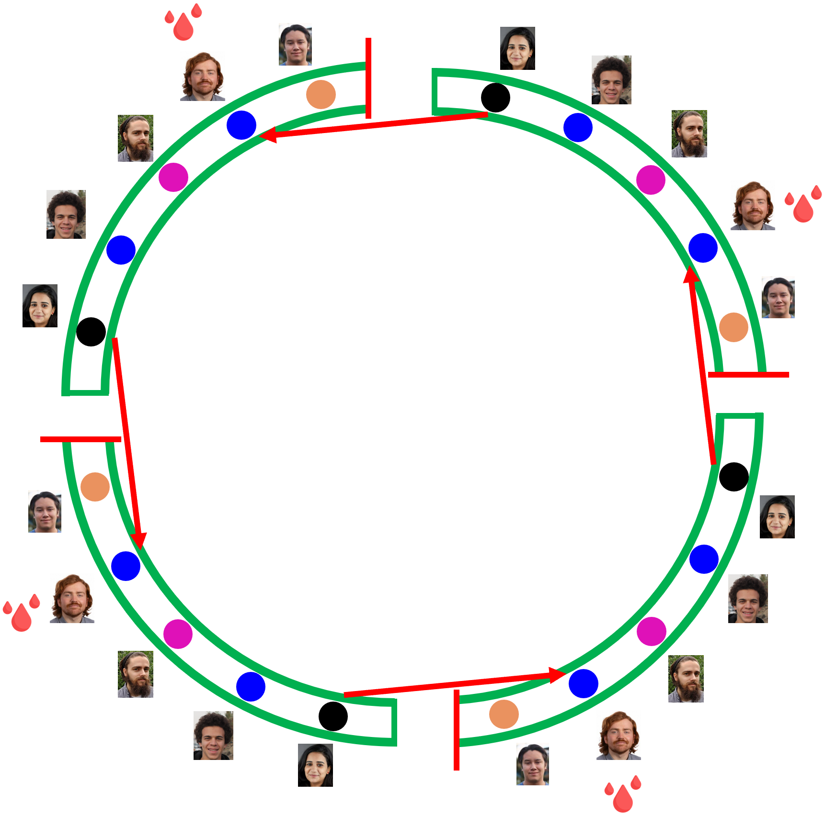



Let’s analyse this
Rotate by 180 degrees
Rotate by 90 degrees
$$R=1$$
$$R=2$$
$$R=4$$
Doesn’t penalize
Penalize a little bit
Penalize more

Slide 44
Ahmed’s goal
PI
Loves high quality blood
Loves mixed blood
Hates disconnectedness
Hates rotational symmetry

Slide 45





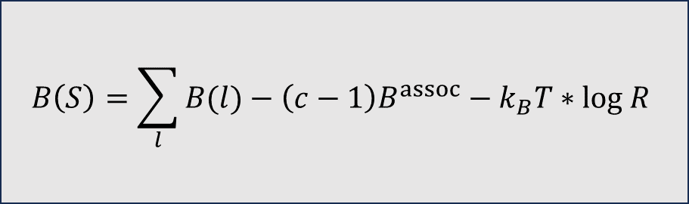

c = 4 sofas
?
Some Criteria/Model
$$l_{5}$$
$$B\left(S\right)=\sum_{l}{B(l)}−\left(c−1\right)B^{assoc}−k_{B}T∗log R$$
$$l_{4}$$
$$l_{3}$$
$$l_{2}$$
$$\max_{S∈Ω}{B(S)}$$
$$l_{1}$$
How to compute this fast?

Slide 46
We are done
Hamilton game
, Ahmed?
Why

Slide 47

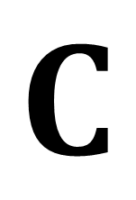


DNA secondary structures
Hamilton game
First year
Second year
Third year
fourth year
Daniel
Augustina
.
.
.
Ahmed
Andre
Paddy
Cormac
.
.
Dara
Solmaz
Oluwayomi
.
.
.
Akash
Yc
Emma
Darshana
.
.
$$G$$
$$A$$
$$C$$
$$T$$
Chemical bonds

Slide 48
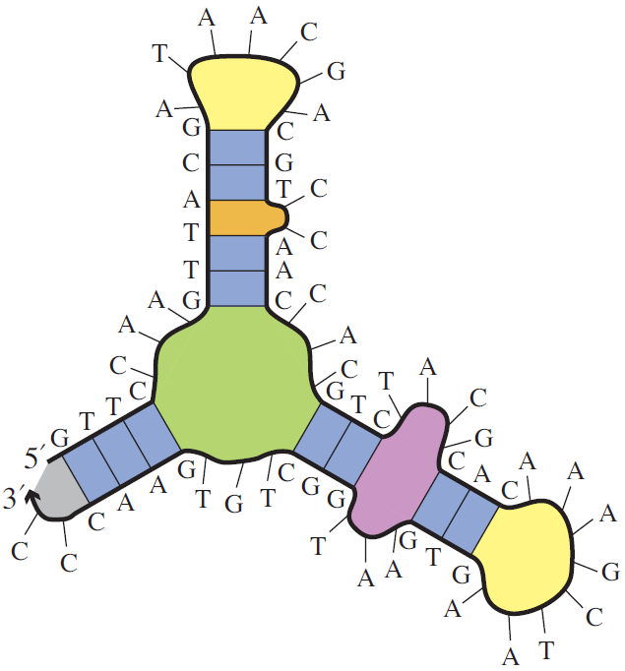

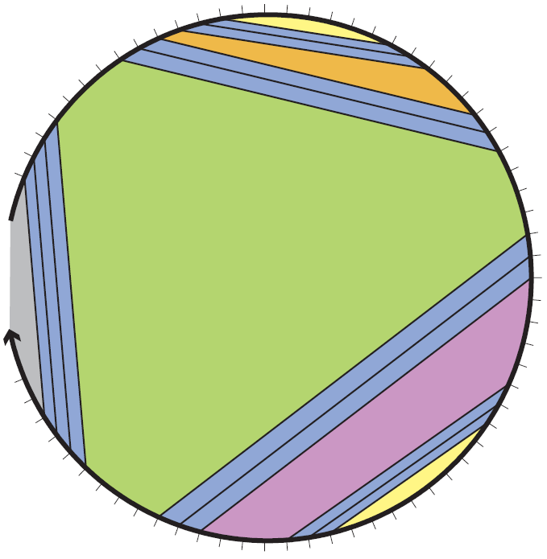
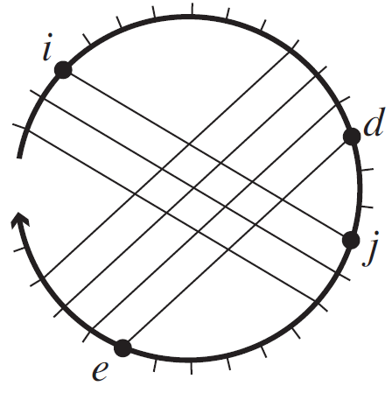
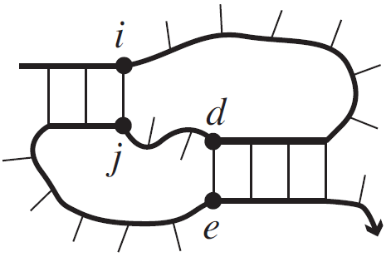

DNA secondary structure
pseudoknot-free
Single stranded DNA
Secondary structure
=
A list of base pairs
Polymer graph representation
$$NP−Hard$$
pseudoknotted

Slide 49
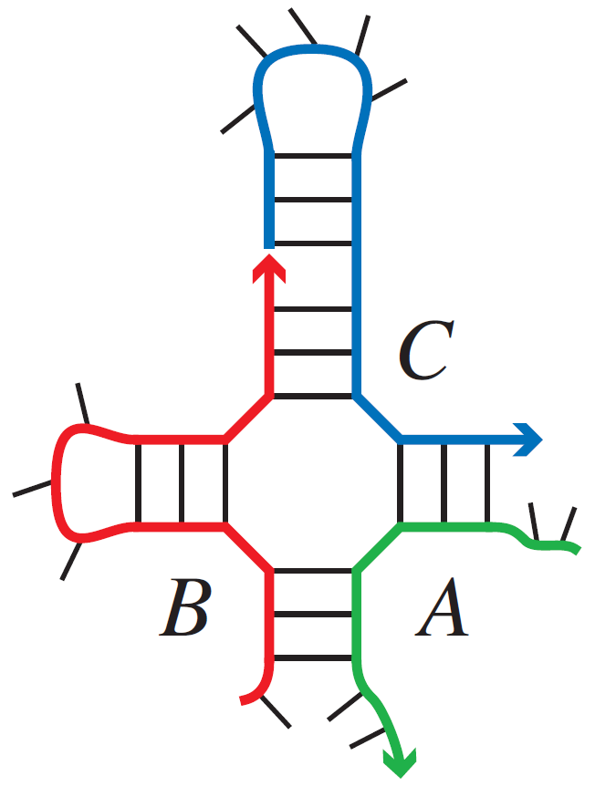
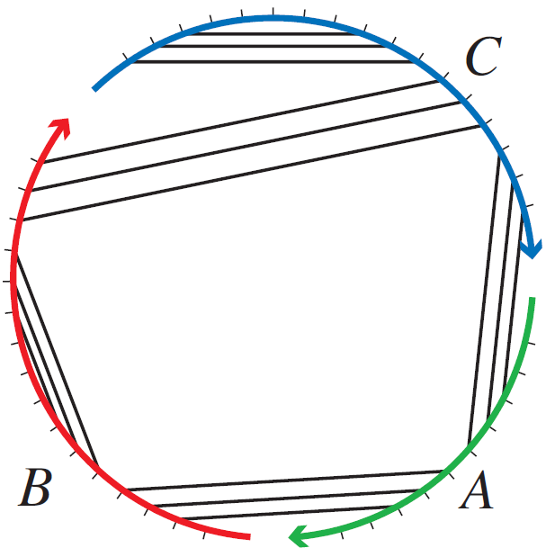



Energy models and Minimum Free Energy
Single stranded system
Multi stranded system of $s$ strands
$$ΔG\left(S\right)$$
Energy model
Capture the free energy
of secondary structure
Free energy
$$MFE= \min_{S∈Ω}{ΔG\left(S\right)}$$
Minimum Free Energy
System secondary structures

Slide 50


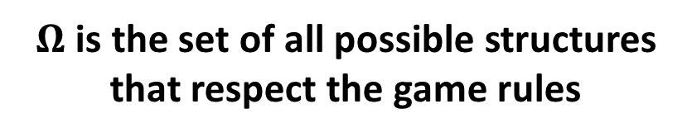
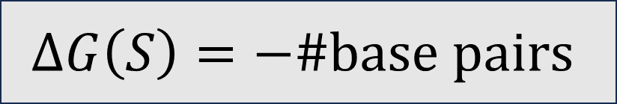

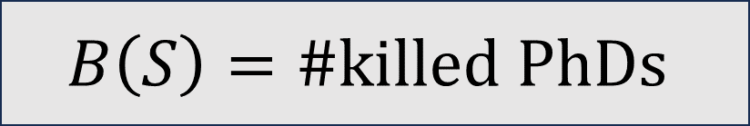
$$1$$
S
?
?
Some Criteria/Model
$$ΔG\left(S\right)=−\#base pairs$$
$$B\left(S\right)=\#killed PhDs$$
$$\min_{S∈Ω}{ΔG(S)}$$
$$\max_{S∈Ω}{B(S)}$$
$Ω$ is the set of all possible structures that respect the game rules
How to compute this fast?
Yes
That is so cool!

Slide 51





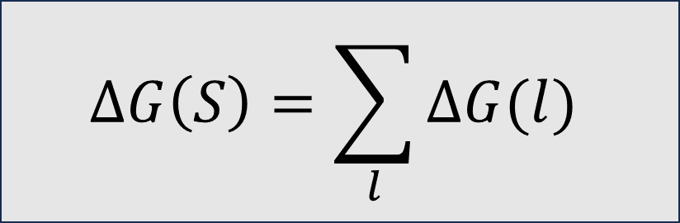





$$S$$
$$2$$
$$l_{5}$$
?
Some Criteria/Model
$$l_{4}$$
$$ΔG\left(S\right)=\sum_{l}{ΔG(l)}$$
$$B\left(S\right)=\sum_{l}{B(l)}$$
$$l_{3}$$
$$l_{2}$$
$$\max_{S∈Ω}{B(S)}$$
$$l_{1}$$
$$\min_{S∈Ω}{ΔG(S)}$$
How to compute this fast?
Yes

Slide 52


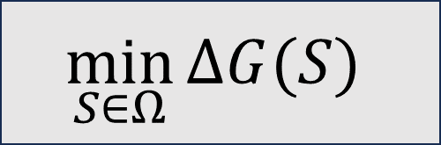


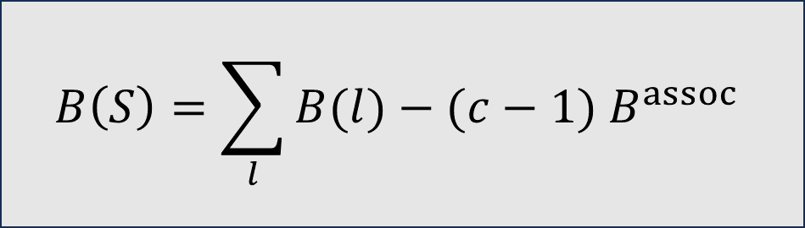
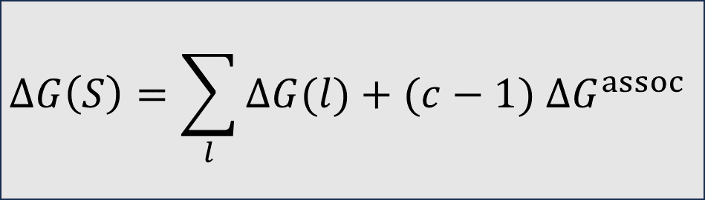





$$S$$
c = 3 sofas
c = 3 strands
$$3$$
$$l_{5}$$
?
Some Criteria/Model
$$l_{4}$$
$$ΔG\left(S\right)=\sum_{l}{ΔG(l)}+(c−1) ΔG^{assoc}$$
$$B\left(S\right)=\sum_{l}{B(l)}−(c−1) B^{assoc}$$
$$l_{3}$$
$$l_{2}$$
$$\max_{S∈Ω}{B(S)}$$
$$\min_{S∈Ω}{ΔG(S)}$$
$$l_{1}$$
$Ω:$ the set of all connected structures that respect the game rules
How to compute this fast?
Yes

Slide 53
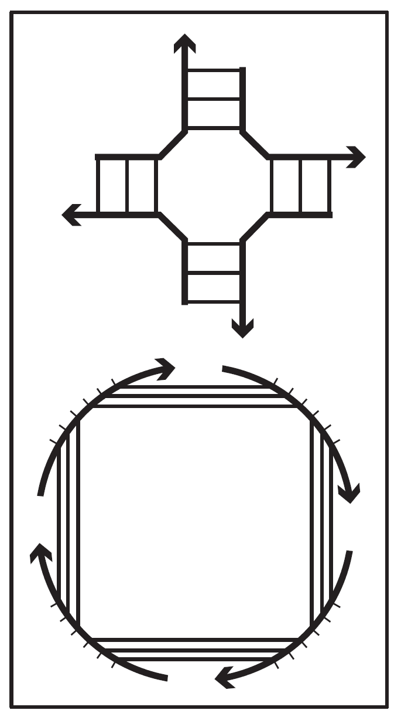
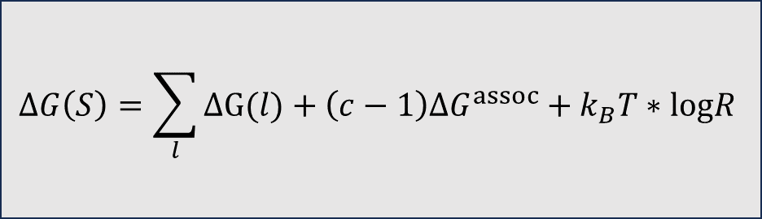




c = 4 strands
$$4$$
c = 4 sofas
?
Some Criteria/Model
$$l_{5}$$
$$B\left(S\right)=\sum_{l}{B(l)}−\left(c−1\right)B^{assoc}−k_{B}T∗logR$$
$$ΔG\left(S\right)=\sum_{l}{ΔG(l)}+\left(c−1\right){ΔG}^{assoc}+k_{B}T∗logR$$
$$l_{4}$$
$$l_{3}$$
$$l_{2}$$
$$\max_{S∈Ω}{B(S)}$$
$$\min_{S∈Ω}{ΔG(S)}$$
$$l_{1}$$
How to compute this fast?
No, till now

Slide 54
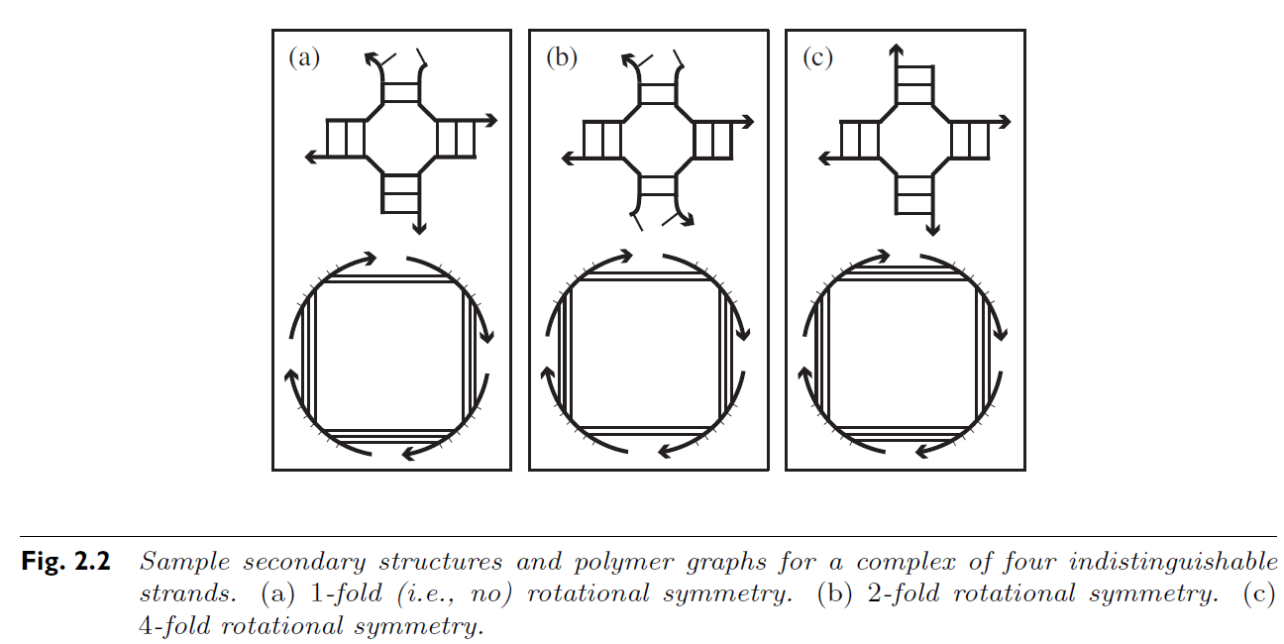




Free energy
Loop energy
Entropic association cost
Symmetry penalty
$$ΔG\left(S\right)= \sum_{l∈S}{ΔG\left(l\right)}+\left(c−1\right)∗∆G^{assoc}+k_{B}T∗logR$$
$$−$$
$$+$$
$$+$$

Slide 55
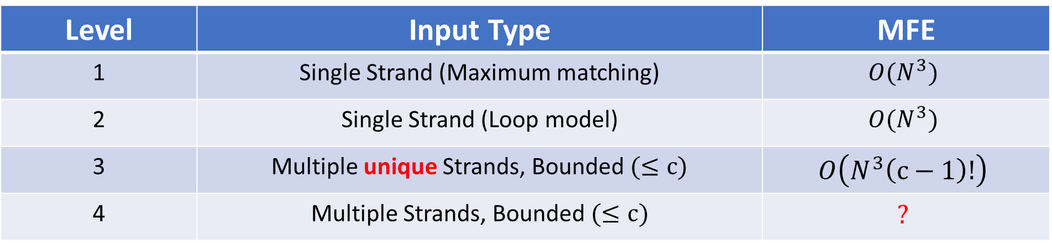


Computational complexity of Minimum Free Energy algorithms
Level | Input Type | MFE
1 | Single Strand (Maximum matching) | $$O(N^{3})$$
2 | Single Strand (Loop model) | $$O(N^{3})$$
3 | Multiple unique Strands, Bounded $(≤c)$ | $$O\left(N^{3}\left(c−1\right)!\right)$$
4 | Multiple Strands, Bounded $(≤c)$ | $$?$$
$N$bases, $c$ strands
Open problem for $≈20$ years

Slide 56

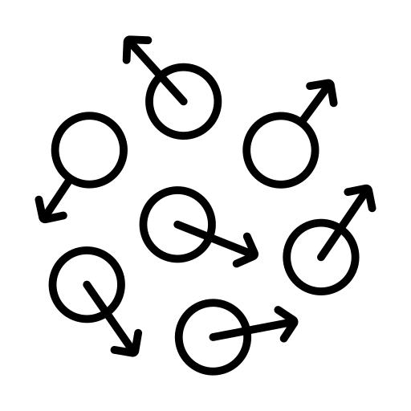
Why symmetry makes that difference?
Entropy

Slide 57

$$ΔG$$
Free energy
Enthalpy
H
Entropy
S

Slide 58


Slide 59








$$S=k_{B}\log{Π}$$
$$N$$
The total number of states of the $N$ magnets is $Π=2^{N}$
$$S=k_{B}N log 2$$
$$\frac{N}{2}$$
$$\frac{N}{2}$$
$$Π=2^{N/2}$$
$S=$ $k_{B}\frac{N}{2}N log 2$

Slide 60
c = 4 sofas
A
A
A
A
That is ugh ugh!

Slide 61

Free energy
Loop energy
Entropic association cost
Symmetry penalty
$$ΔG\left(S\right)= \sum_{l∈S}{ΔG\left(l\right)}+\left(c−1\right)∗∆G^{assoc}+k_{B}T∗logR$$

Slide 62
Why is this difficult?

Slide 63


Computational complexity of Minimum Free Energy algorithms
Level | Input Type | MFE
1 | Single Strand (Maximum matching) | $$O(N^{3})$$
2 | Single Strand (Loop model) | $$O(N^{3})$$
3 | Multiple unique Strands, Bounded $(≤c)$ | $$O\left(N^{3}\left(c−1\right)!\right)$$
4 | Multiple Strands, Bounded $(≤c)$ | $$?$$
$N$bases, $c$ strands
All of these are dynamic programming algorithms
Subproblems
Big problem

Slide 64


All of these are dynamic programming algorithms
Subproblems
Big problem
Local point of view
?
Global property

Slide 65


Computational complexity of Minimum Free Energy algorithms
Level | Input Type | MFE
1 | Single Strand (Maximum matching) | $$O(N^{3})$$
2 | Single Strand (Loop model) | $$O(N^{3})$$
3 | Multiple unique Strands, Bounded $(≤c)$ | $$O\left(N^{3}\left(c−1\right)!\right)$$
4 | Multiple Strands, Bounded $(≤c)$ | $$?$$
$N$bases, $c$ strands
$$B\left(S\right)=\sum_{l}{B(l)}−(c−1) B^{assoc}$$
$$B\left(S\right)=\sum_{l}{B(l)}−\left(c−1\right)B^{assoc}−k_{B}T∗logR$$

Slide 66
Let’s ignore the symmetry for a while

Slide 68


$$B\left(S\right)$$
$$Ω$$

Slide 69

$$B\left(S\right)$$
$$Ω$$

Slide 70

$$1$$
$$B\left(S\right)$$
$$Ω$$

Slide 71

$$2$$
$$B\left(S\right)$$
$$Ω$$

Slide 72



$$2$$
$$k_{B}T∗log R$$
$$B\left(S\right)$$
$$Ω$$

Slide 73

$$2$$
$$Huge$$
$$B\left(S\right)$$
$$Ω$$

Slide 74

Is there any hope?

Slide 75


Slide 76

Yasso

Slide 77


Slide 78


Slide 79


Slide 80
Last summer, we went to Japan

Slide 81



Slide 82

Yasso loves

Slide 83


Slide 85


Slide 86



Slide 87


Slide 89

كله تمام يا خالو أحمد!

Slide 90








$$S_{x}$$
Symmetric
$$B\left(S\right)$$
$$X$$
$S_{x}$ and $S_{y}$
Admissible cut
$${B(S}_{y})≤B(S_{x})$$
$$S_{z}$$
Asymmetric
$${B(S}_{y})≤B(S_{z})≤B(S_{x})$$
$$S_{y}$$
Symmetric

Slide 91
The sandwich theorem of secondary structures
Does this solve the problem?

Slide 92


$$2$$
$$Huge$$
$$B\left(S\right)$$
$$Ω$$

Slide 93
$$2$$
$$Huge$$
$$B\left(S\right)$$
$$Ω$$

Slide 94
$$2$$
$$Huge$$
$$B\left(S\right)$$
$$Ω$$

Slide 95



$$S_{x}$$
Upper bound
$$B\left(S\right)$$
$$X$$
$${B(S}_{y})≤B(S_{x})$$
$$S_{z}$$
$${B(S}_{y})≤B(S_{z})≤B(S_{x})$$
$$+$$
$$S_{y}$$

Slide 96

$$2$$
$$Small$$
$$B\left(S\right)$$
$$Ω$$

Slide 97


Slide 98
Computational complexity of Minimum Free Energy algorithms
Level | Input Type | MFE
1 | Single Strand (Maximum matching) | $$O(N^{3})$$
2 | Single Strand (Loop model) | $$O(N^{3})$$
3 | Multiple unique Strands, Bounded $(≤c)$ | $$O\left(N^{3}\left(c−1\right)!\right)$$
4 | Multiple Strands, Bounded $(≤c)$ | $$?$$
$N$bases, $c$ strands
Open problem for $≈20$ years

Slide 99


Computational complexity of Minimum Free Energy algorithms
Level | Input Type | MFE
1 | Single Strand (Maximum matching) | $$O(N^{3})$$
2 | Single Strand (Loop model) | $$O(N^{3})$$
3 | Multiple unique Strands, Bounded $(≤c)$ | $$O\left(N^{3}\left(c−1\right)!\right)$$
4 | Multiple Strands, Bounded $(≤c)$ | $$O\left(N^{4}\left(c−1\right)!\right)$$
$N$bases, $c$ strands

Slide 100





Thanks
dna.hamilton.ie
dna.hamilton.ie/shalaby

